Slide 1
Project 3
Writing Ryu/ONOS Application
Date: | 2019/03/14 (Thu.)
Deadline: | 2019/04/04 (Thu.)

Slide 2
Outline
Create Ryu Application
Create ONOS Application
Project 3 Requirements
Ryu
ONOS

Slide 3
Outline
Create Ryu Application
Create ONOS Application
Project 3 Requirements
Ryu
ONOS

Slide 4
Create Ryu Application
Writing Ryu/ONOS Application
Notes:
說明有兩種方式 CLI AND restful api

Slide 5
Create and Run Ryu Application
Write your Ryu application, say `yourapp.py`
Run `yourapp.py`
Run application in relative paths, say you put `yourapp.py` under ~/ryu/ryu/app/
$ ryu-manager yourapp.py
$ ryu-manager ryu.app.yourapp

Slide 6
Reference
Ryu Documents – Writing Your Ryu Application
https://ryu.readthedocs.io/en/latest/developing.html
Ryubook (English/Chinese version)
https://osrg.github.io/ryu-book/en/html/index.html
https://osrg.github.io/ryu-book/zh_tw/html/index.html

Slide 7
Outline
Create Ryu Application
Create ONOS Application
Project 3 Requirements
Ryu
ONOS

Slide 8
Create ONOS Application
Writing Ryu/ONOS Application
Notes:
說明有兩種方式 CLI AND restful api

Slide 9
Environment Setup
Setup ONOS profile
Install Maven
$ vi ~/.bashrc
# Add following lines into ~/.bashrc
export ONOS_ROOT=~/onos
source $ONOS_ROOT/tools/dev/bash_profile
$ sudo apt install maven

Slide 10
Publish the artifacts to local repository
First build ONOS if you haven’t build or run it
Note: Skip this step if you have built ONOS before
Publish ONOS libraries only
Build the current version of the ONOS application archetypes
$ op
$ onos-publish -l
$ cd $ONOS_ROOT/tools/package/archetypes
$ mvn clean install

Slide 11
Create ONOS Application (I)
Indicate version of ONOS API
Create ONOS application (Red words are what you type)
$ export ONOS_POM_VERSION=1.15.0
$ onos-create-app
…
[INFO] …
Define value for property 'groupId': nctu.winlab
Define value for property 'artifactId': test-app
Define value for property 'version' 1.0-SNAPSHOT: : <enter>
Define value for property 'package' nctu.winlab: : nctu.winlab.testapp
Confirm properties configuration:
groupId: nctu.winlab
artifactId: test-app
version: 1.0-SNAPSHOT
package: nctu.winlab.testapp
Y: : <enter>
[INFO] …
[INFO] BUILD SUCCESS

Slide 12
Create ONOS Application (II)
A folder named `artifactId` is created after the previous step
Uncomment and modify line 34 and 36 in `pom.xml` with your package name and arbitrary origin
$ cd <artifactId>
$ vi pom.xml
# Uncomment and modify the following two lines
<onos.app.name>nctu.winlab.testapp</onos.app.name>
<onos.app.origin>Winlab, NCTU</onos.app.origin>

Slide 13
Write ONOS Application
You code should be placed under `src/main/java/nctu/winlab/testapp/`
A template code is created , and you can simply use it
$ cd <artifactId>
$ vi src/main/java/nctu/winlab/testapp/AppComponent.java

Slide 14
Compile, Install and Activate ONOS Application
Compile ONOS application
Run ONOS
Install and activate ONOS application
Note: By using an exclamation mark with `install` parameter, the application will be activated immediately after being installed
$ cd <artifactId>
$ mvn clean install -DskipTests
$ ok clean
$ onos-app localhost install! target/<package>-<version>.oar

Slide 15
Reference
ONOS Wiki – Template Application Tutorial
https://wiki.onosproject.org/display/ONOS/Template+Application+Tutorial
ONOS Java API (1.15.0)
http://api.onosproject.org/1.15.0/apidocs/

Slide 16
Outline
Create Ryu Application
Create ONOS Application
Project 3 Requirements
Ryu
ONOS

Slide 17
Project 3 Requirements
Writing Ryu/ONOS Application
Notes:
說明有兩種方式 CLI AND restful api

Slide 18
Outline
Create Ryu Application
Create ONOS Application
Project 3 Requirements
Ryu
ONOS

Slide 19
In Lab 1
SDN Hub ryu-starter-kit in Lab 1
https://bitbucket.org/sdnhub/ryu-starter-kit/
Start ryu-starter-kit
Start Mininet
Ping between all hosts
$ cd ~/ryu
$ ./ryu/app/sdnhub_apps/run_sdnhub_apps.sh
$ sudo mn --controller=remote --topo=tree,depth=2
mininet> pingall

Slide 20
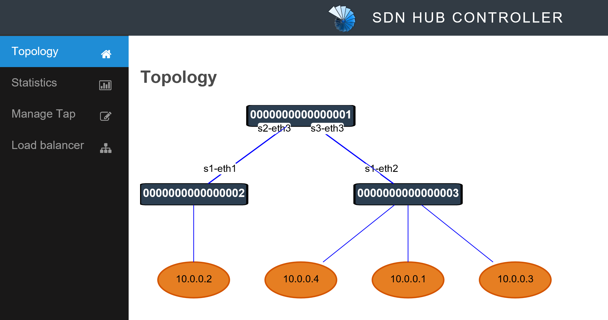
Web GUI in ryu-starter-kit
Open web GUI on http://localhost:8080
The topology in web GUI is not correct

Slide 21
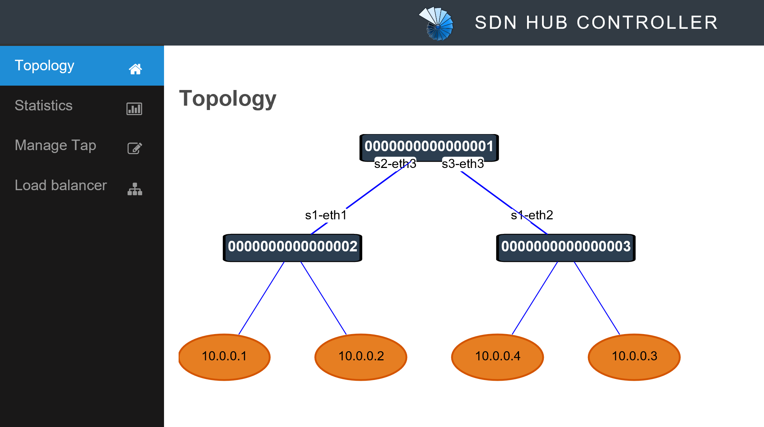
Host Location Tracker
Ping between hosts under same switches
It simply uses the last updated MAC to port table
mininet> h1 ping h2
mininet> h3 ping h4

Slide 22
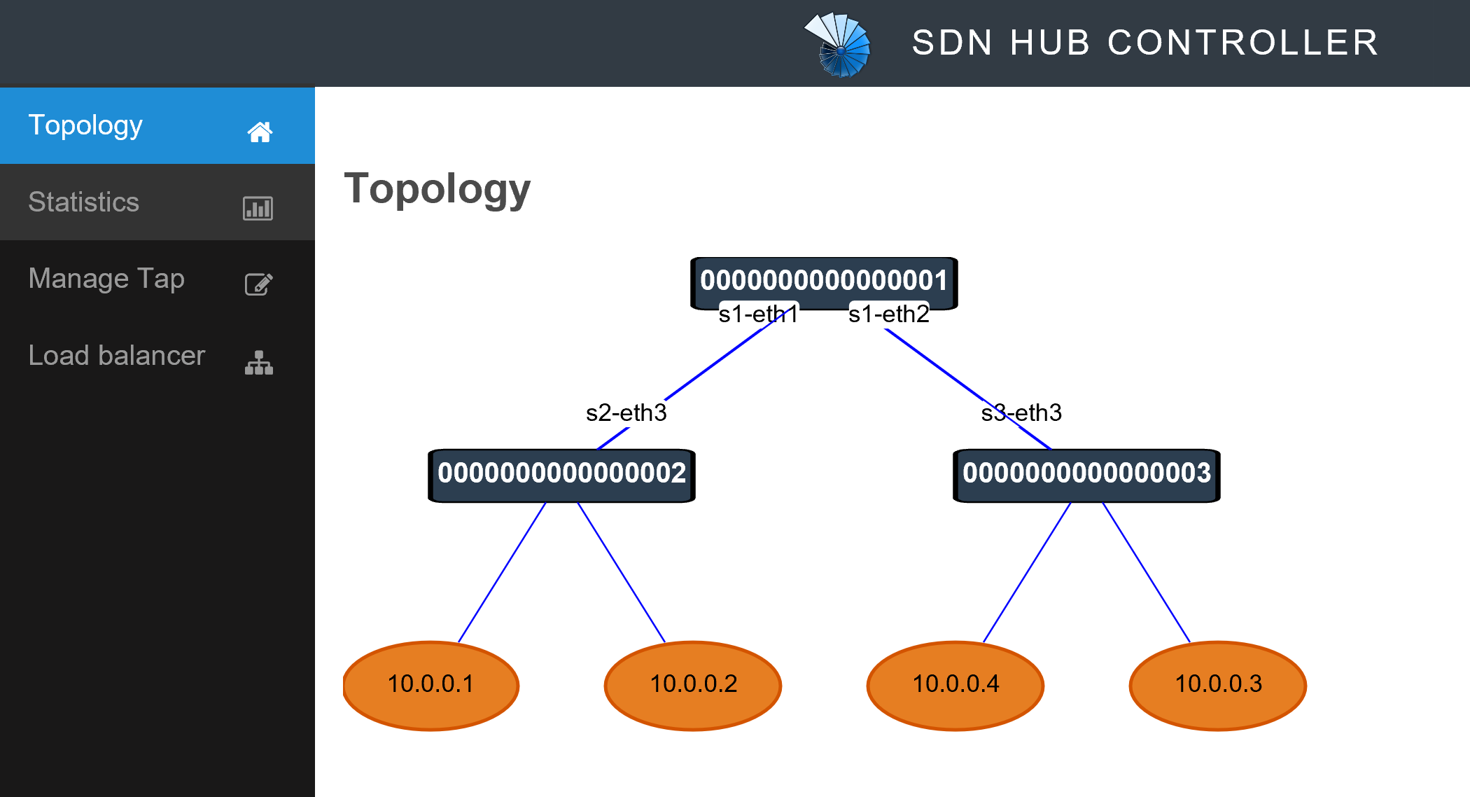
Ryu Requirements
Please fix the bugs of web GUI in ryu-starter-kit, including
Host location
Port name of device link
Hint: Host location tracker is implemented in `host_tracker.py`
The correct web GUI should be as following

Slide 23
Reference
Strongly recommend to go through Ryu’s built-in application for learning bridge function
SimpleSwitch13
https://github.com/osrg/ryu/blob/master/ryu/app/simple_switch_13.py
https://osrg.github.io/ryu-book/zh_tw/html/switching_hub.html

Slide 24
Outline
Create Ryu Application
Create ONOS Application
Project 3 Requirements
Ryu
ONOS

Slide 25
ONOS Requirement
Write an application of learning bridge function
Update MAC to port table when receiving packet-INs
Check if there is record in MAC to port table
If yes, install flow rules matching destination MAC address and outputting to port
Otherwise, flood packets
Test your application with tree topology
Ping should work between all hosts
$ sudo mn --controller=remote --topo=tree,depth=2
mininet> pingall

Slide 26
Reference
Ryu SimpleSwitch13 application
https://osrg.github.io/ryu-book/zh_tw/html/switching_hub.html
ONOS ReactiveForwarding application
https://github.com/opennetworkinglab/onos/blob/onos-1.15/apps/fwd/src/main/java/org/onosproject/fwd/ReactiveForwarding.java
Note: Make sure that you checkout to branch `onos-1.15`
Hint: Use log or Wireshark on hosts to debug

Slide 27
Submit to e3
Files
Ryu
All files under `sdnhub_apps`
ONOS
All files under your created application directory
Submit
Upload “.zip” file to e3
Named: project3_studentID.zip
Wrong file name or format would not be scored

Slide 28
Thank you
Q & A

